Slide 1


[{{{
Final Python Project
Music Player Using Tkinter (GUI Interface)

Slide 2
Music Playback
Music Library management
User Interface
Audio Equalization
Cross platform Compatibility
Media Control
Long term goal & major application

Slide 3

Libraries & Modules
Tkinter
os
Pygame
Pydub
PIL

Slide 4

Modules Description
Pygame is a game development toolkit for producing 2D games and multimedia applications.
Tkinter is a GUI library for creating desktop applications with graphical user interfaces this is inbuilt module in the python and no requirement is needed for installation. It’s a standard library.
Pydub is an audio processing library for reading, modifying, and exporting audio files in Python. Its a function that is used to manipulate, read & export audio files in various formats. This library function allows developers to slicing, concatenating and exporting.

Slide 5
In order to communicate with the operating system, the os module is imported. In particular, it is used to extract a list of files from a directory and add them to the music player GUI's song list box.
Image: This module offers classes and techniques for navigating, editing, and storing a variety of image file types. It is frequently employed for image processing operations like scaling, cropping, filtering, and more.
ImageTk: This module offers classes and procedures for incorporating PIL pictures into tkinter GUI programs. In tkinter windows and widgets like labels, buttons, and canvases, you may show images.

Slide 6
Understanding the code lines
self.disc_image = Image.open(disc_image_path).
self.disc_image = self.disc_image.resize(300, 300)
self.disc_photo = ImageTk.PhotoImage(self.disc_image)
self.disc_label = tk.Label(self.root, image=self.disc_photo, bg="black")
self.song_listbox = tk.Listbox(self.root, height=15, width=50, font=("Times New Roman", 12), bg="#2C2C2C", fg="white", selectbackground="#004BA8", selectforeground="white")
self.song_listbox.insert(tk.END, song)
self.play_button = tk.Button(self.root, text="PLAY", width=10, font=("Times New Roman", 14, "bold"), bg="#004BA8", fg="white", activebackground="#00336E", command=self.play_song)

Slide 7
self.pause_button = tk.Button(self.root, text="PAUSE", width=10, font=("Times New Roman", 14, "bold"), bg="#004BA8", fg="white", activebackground="#00336E", command=self.pause_song)
self.stop_button = tk.Button(self.root, text="STOP", width=10, font=("Times New Roman", 14, "bold"), bg="#004BA8", fg="white", activebackground="#00336E", command=self.stop_song)
self.volume_slider = tk.Scale(self.root, from_=0, to=100, orient=tk.HORIZONTAL, length=500, sliderlength=20, width=15, font=("Times New Roman", 12), bg="blue", fg="white", highlightbackground="WHITE", troughcolor="black", command=self.set_volume)
self.theme_label, self.theme_var, self.theme_var.set("Default"), self.theme_menu, self.change_theme(self, theme)

Slide 8
Challenges Encountered
File paths
Error handling
UI design
Music file format support
Organization and modularity of the code
Code efficiency
Platform compatibility

Slide 9
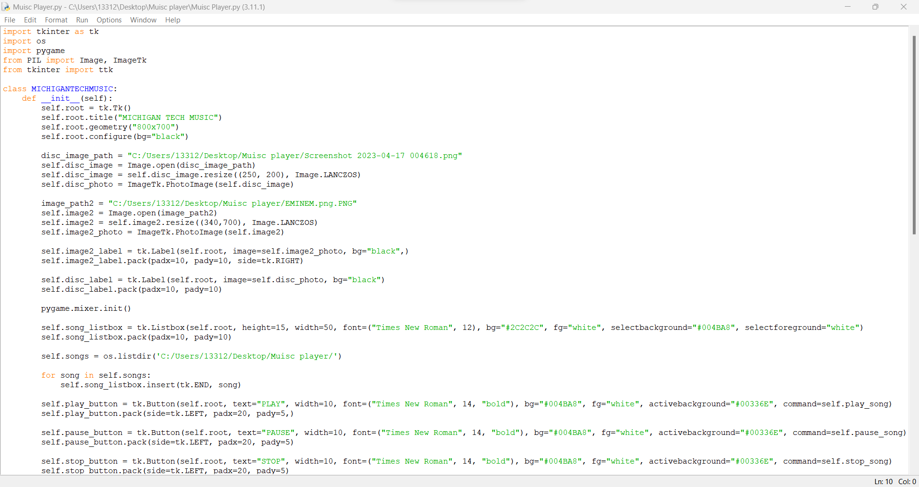
CODE

Slide 10
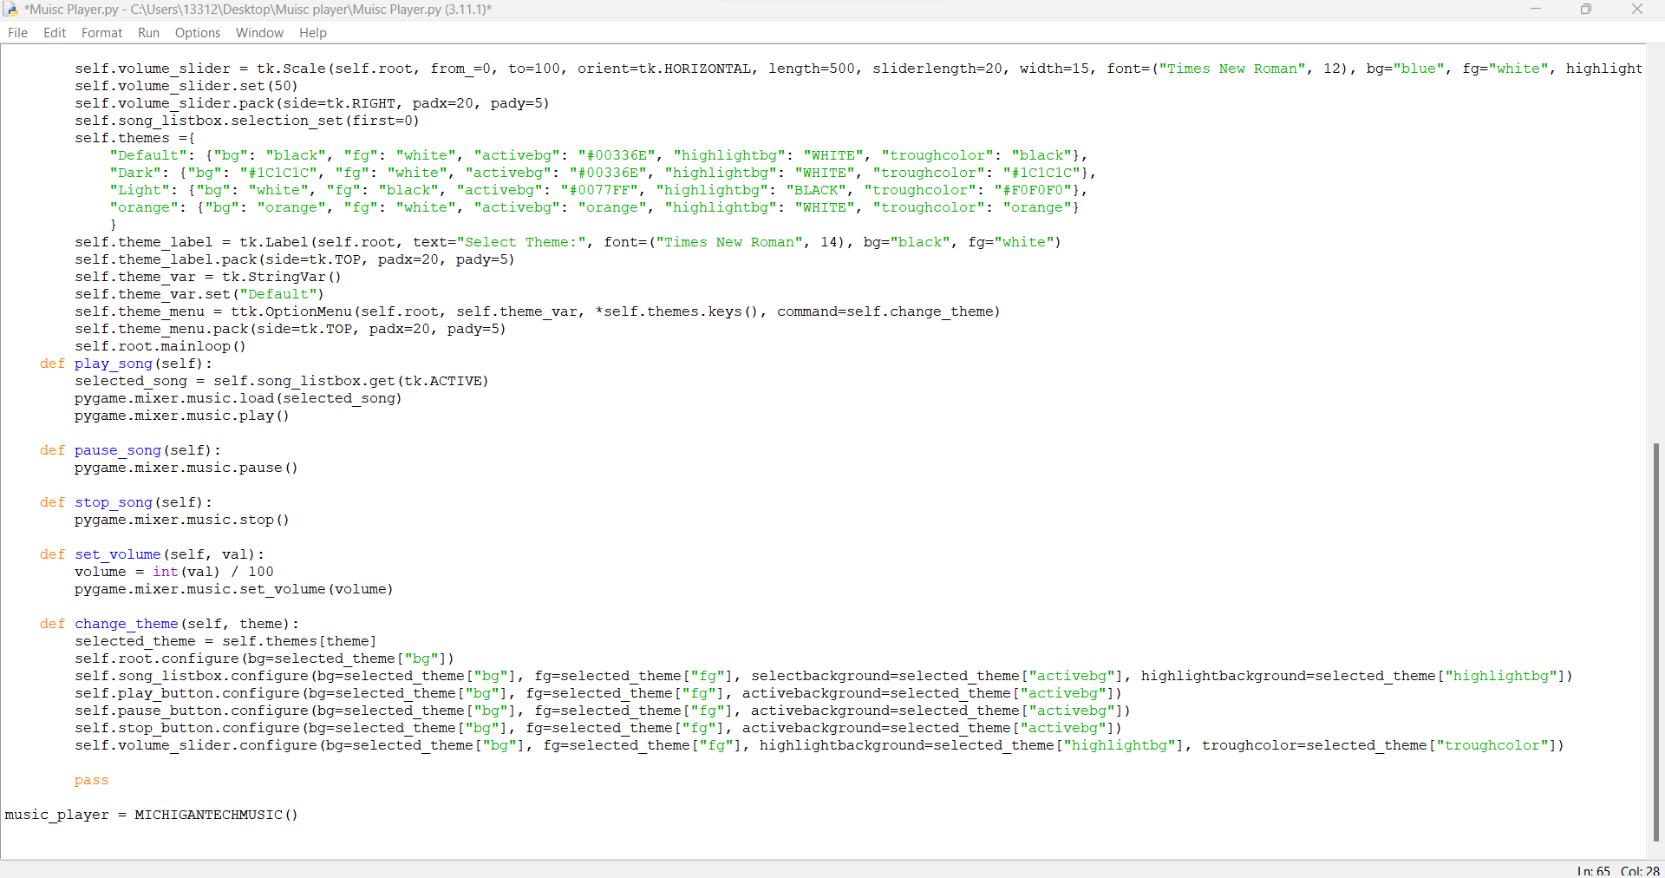

Slide 11
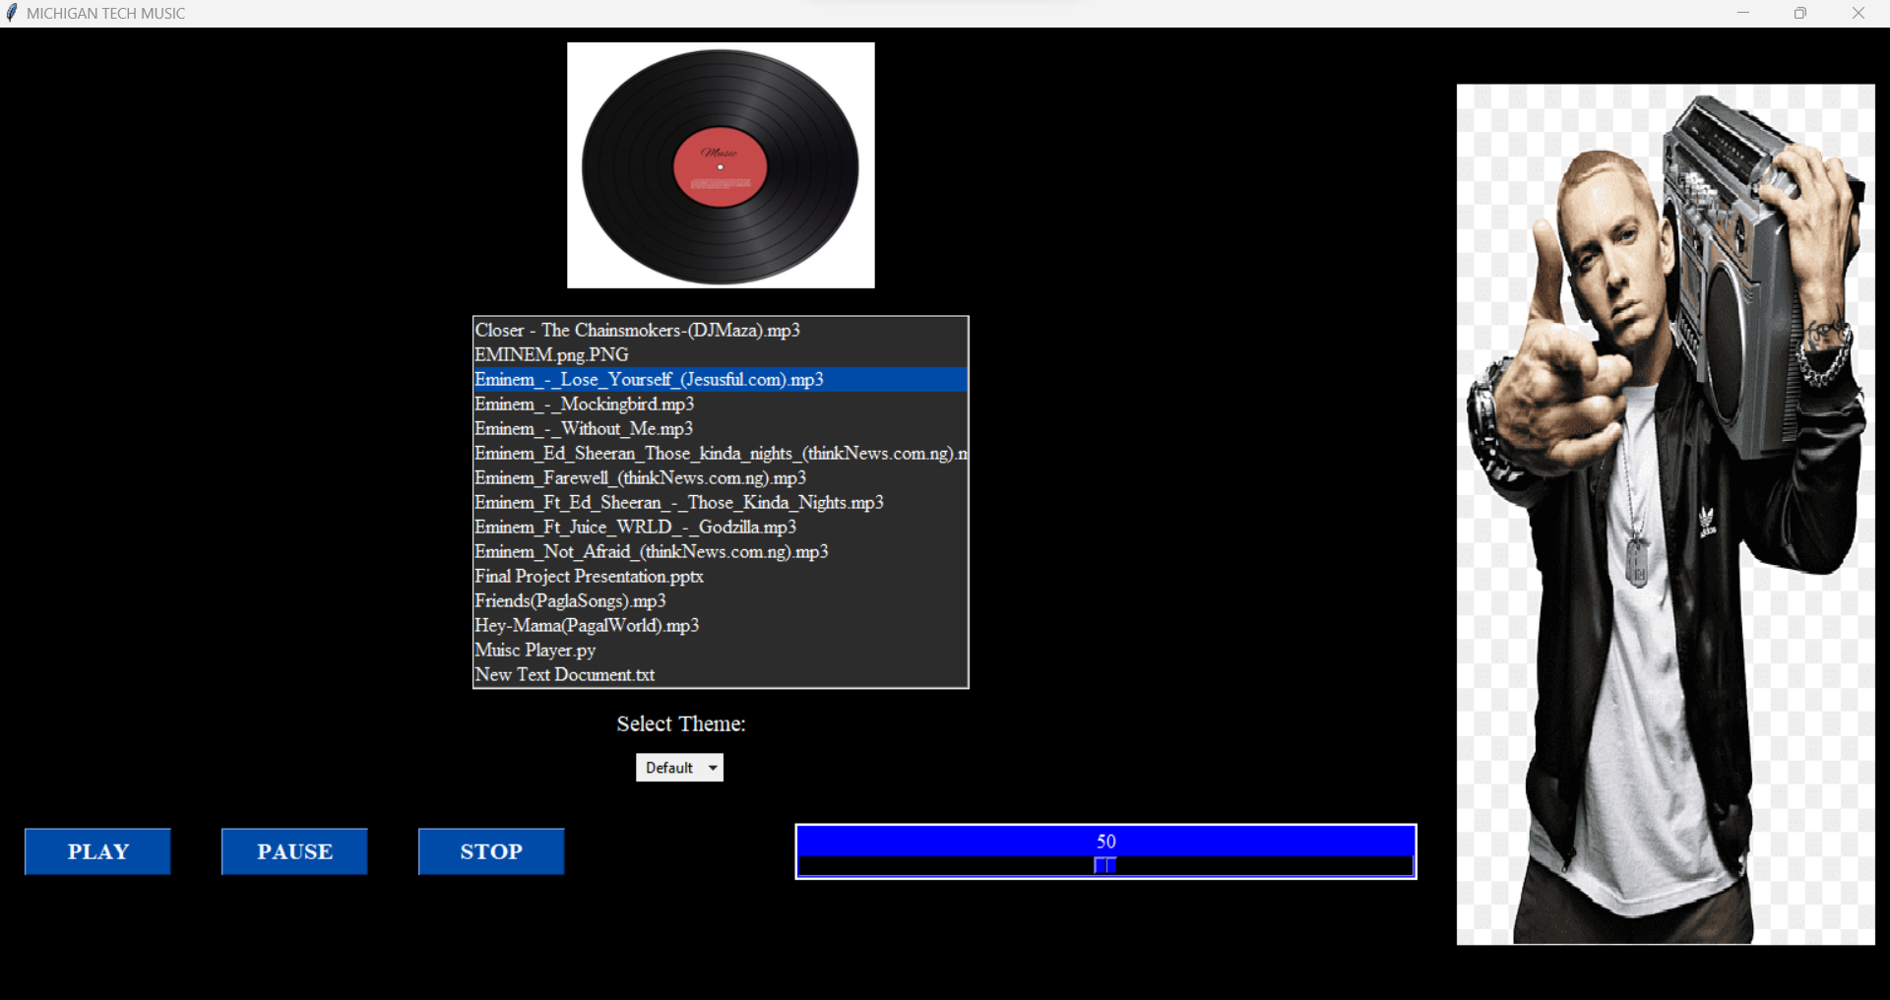
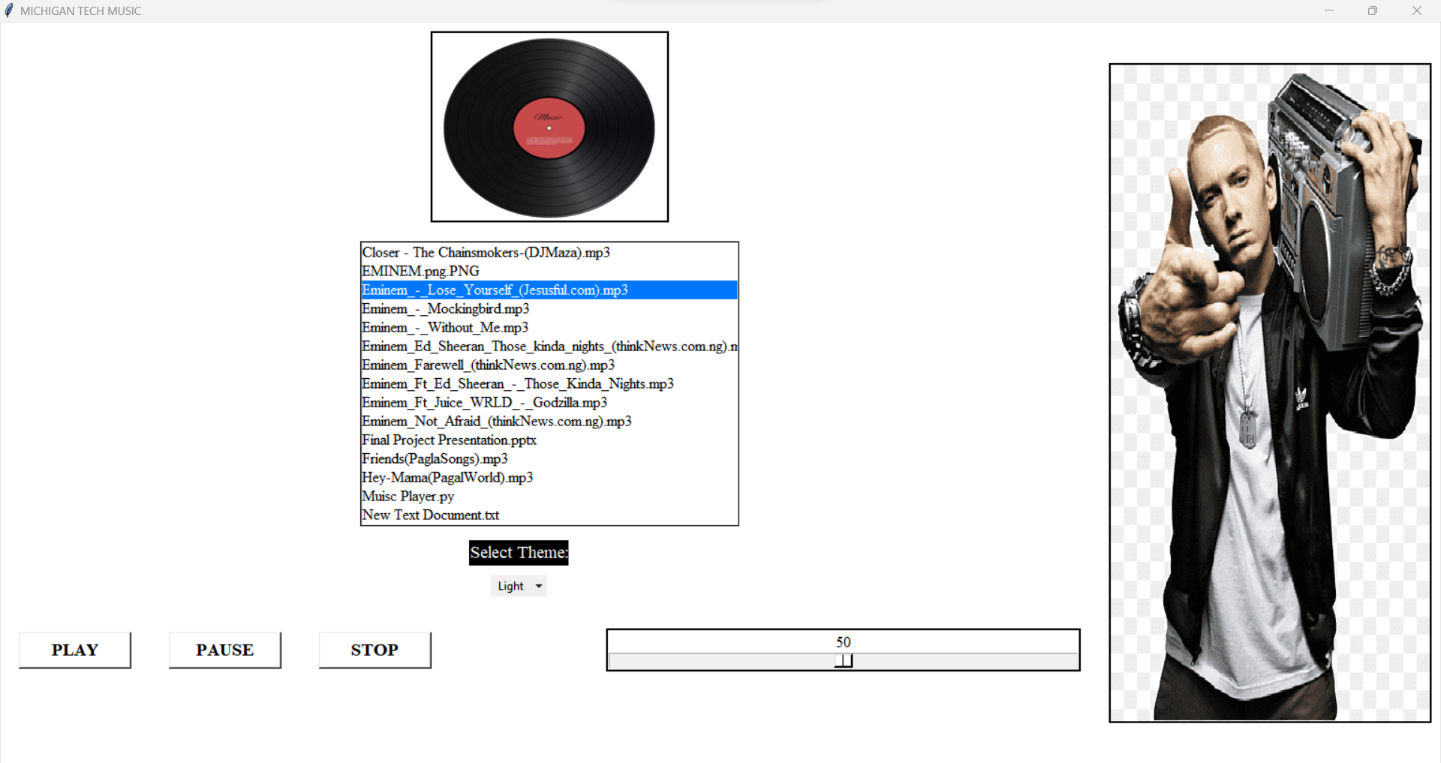
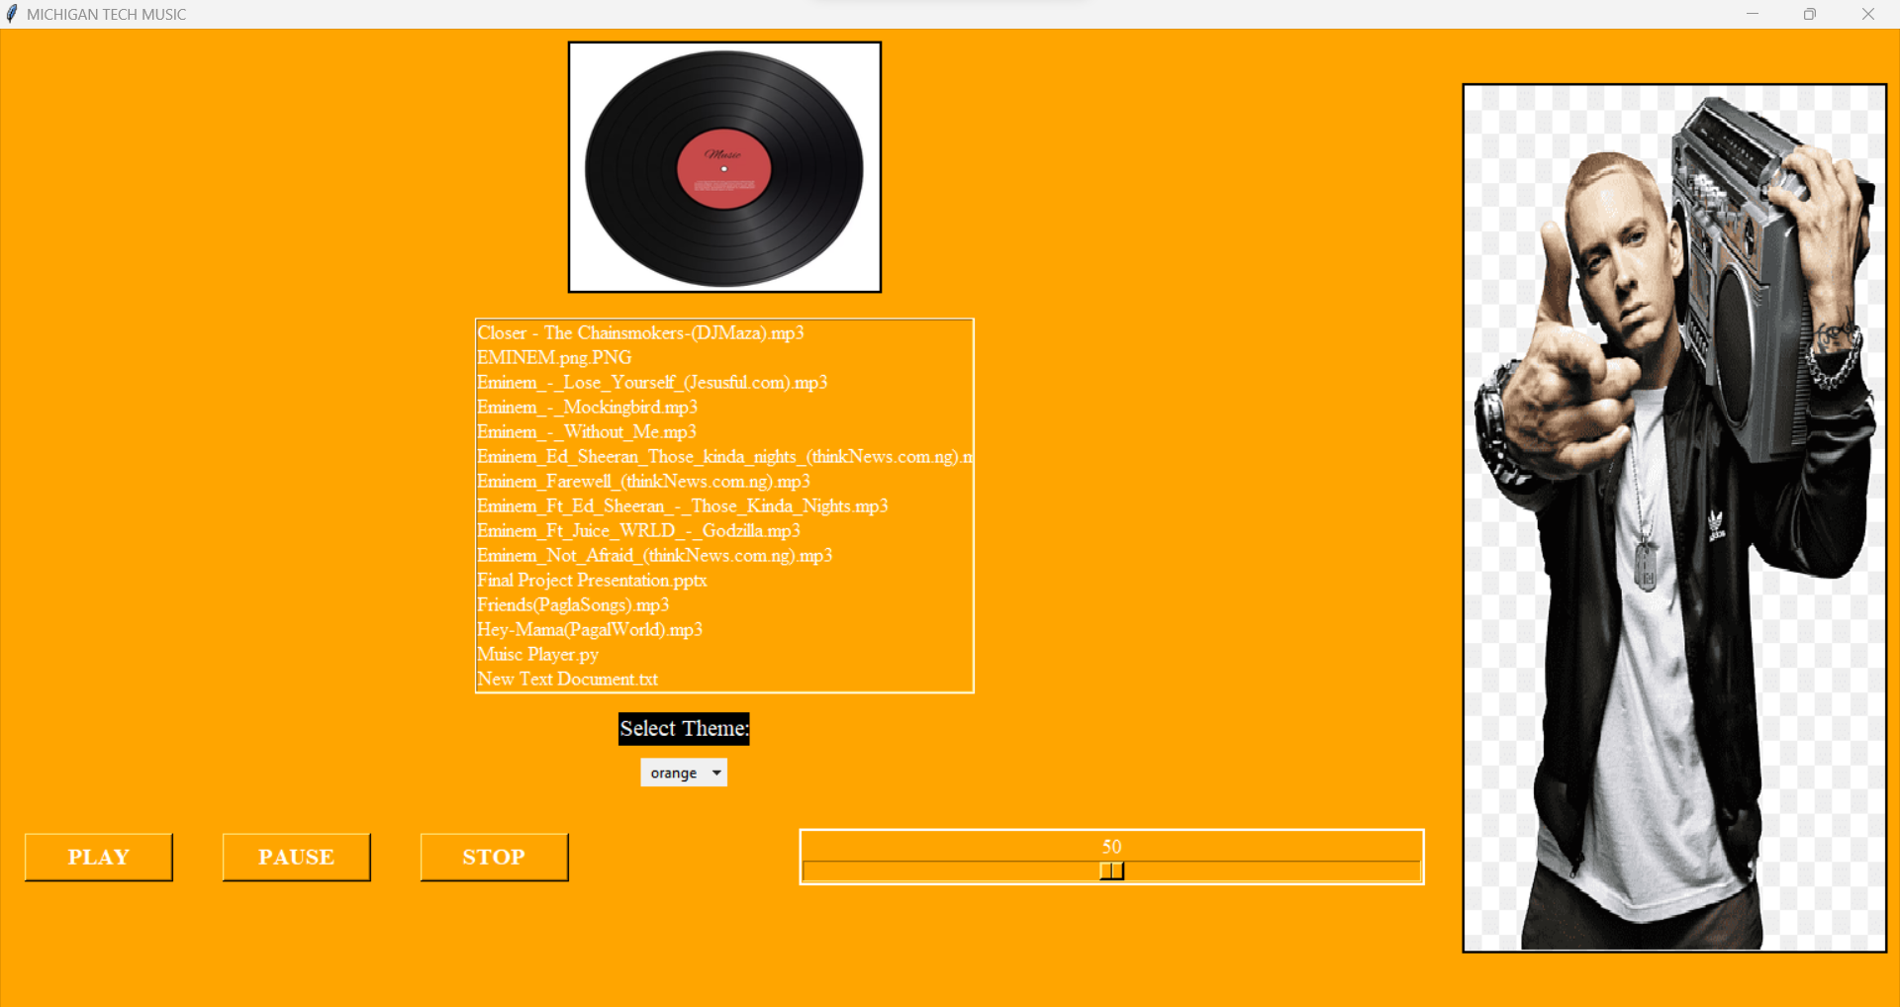
Output – Music interface

Slide 12
Current Music Applications & Trends
The backend programming for Spotify & Apple music was created using a microservices architecture. This indicates that the code has been divided into a number of separate, independent services, each of which is responsible for handling a particular task, such as playlist generation, user authentication, and music playback. Many computer languages, including Java, Scala, and Python, are used to create these services. They use a variety of data storage technologies, including Cassandra, MySQL, and Kafka, and they connect with one another through APIs (Application Programming Interfaces).A sizable, distributed database that is built to accommodate the enormous amounts of data that Spotify maintains houses the music data. To assess user listening patterns and produce tailored recommendations, Spotify combines its own algorithms with machine learning.

Slide 13
Thank You

